Slide 1

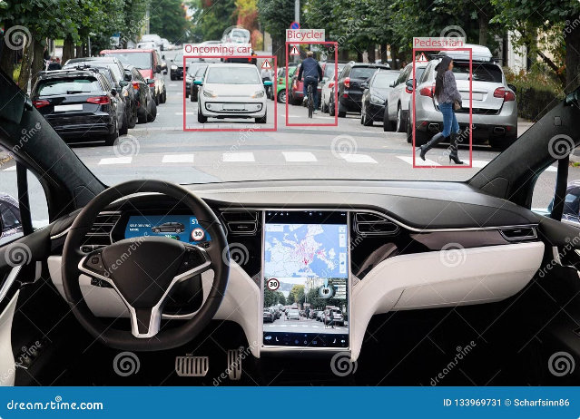
Image Segmentation: U-Net For Self Driving Cars
This presentation explores the development and application of a U-Net-based image segmentation model for autonomous vehicle navigation.

Slide 2

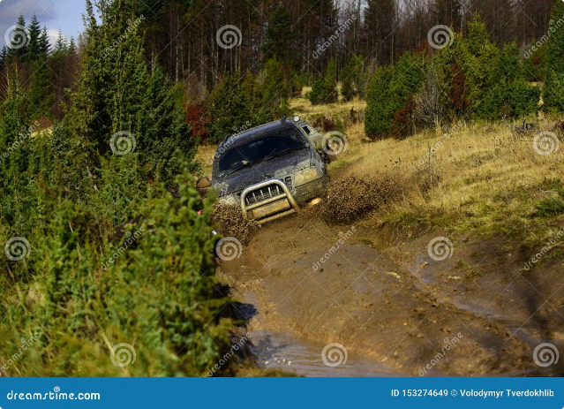
Problem Statement
1
Autonomous Driving Safety
Ensuring safe and efficient navigation for self-driving cars.
2
Real-Time Perception
Accurate identification and segmentation of key objects like roads, lanes, traffic lights, and pedestrians.
3
Complex Environments
Handling diverse and dynamic road conditions, including weather, lighting, and traffic variations.

Slide 3
System Description
Input
Output
Development Work
Real-time images from car cameras.
Segmented images highlighting key objects.
U-Net architecture implemented using TensorFlow, trained on labeled datasets.

Slide 4

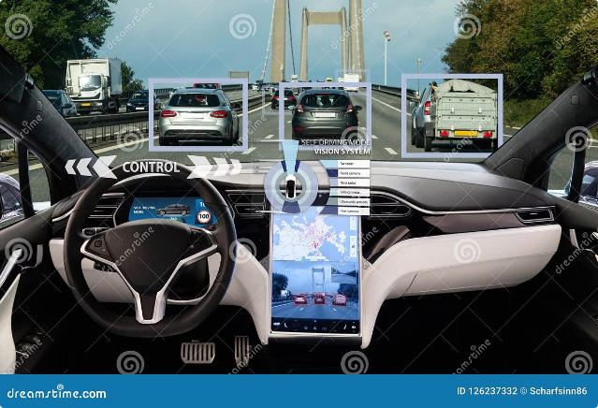
Evaluation and Limitations
Metric
Value
Accuracy
95% (average)
Precision
97% (average)
Recall
93% (average)

Slide 5




Lessons Learned - Teamwork
Communication
Open and clear communication was crucial for successful collaboration.
Role Specialization
Dividing tasks based on team members' strengths and expertise.
Regular Feedback
Frequent feedback loops ensured progress and addressed potential issues early on.

Slide 6


Lessons Learned - Development Work
TensorFlow
Gained expertise in using TensorFlow for deep learning model development.
Data Augmentation
Implementing data augmentation techniques to improve model robustness.
Hyperparameter Tuning
Optimizing model performance by carefully tuning hyperparameters.

Slide 7





Lessons Learned - Communication
Presentations
Clear and concise presentations effectively conveyed project progress and results.
Documentation
Thorough documentation ensured knowledge sharing and future reference.
Discussions
Regular discussions fostered knowledge sharing and collaborative problem-solving.

Slide 8


Lessons Learned - Course Knowledge
1
Deep Learning Foundations
Reinforced understanding of deep learning concepts and algorithms.
2
Image Segmentation Techniques
Acquired practical experience with various image segmentation methods.
3
Autonomous Vehicle Technology
Gaining insights into the broader context of autonomous vehicle development.

